Slide 1
Ensemble Classification Methods: Bagging, Boosting, and Random Forests
Zhuowen Tu
Lab of Neuro Imaging, Department of Neurology
Department of Computer Science
University of California, Los Angeles
Some slides are due to Robert Schapire and Pier Luca Lnzi

Slide 2
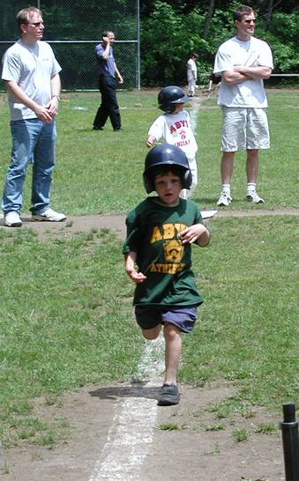
Discriminative v.s. Generative Models
Generative and discriminative learning are key problems in machine learning and computer vision.
If you are asking, “Are there any faces in this image?”, then you would probably want to use discriminative methods.
If you are asking, “Find a 3-d model that describes the runner”,
then you would use generative methods.
ICCV W. Freeman and A. Blake

Slide 3
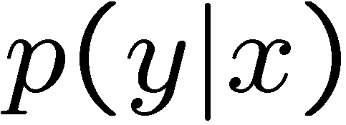
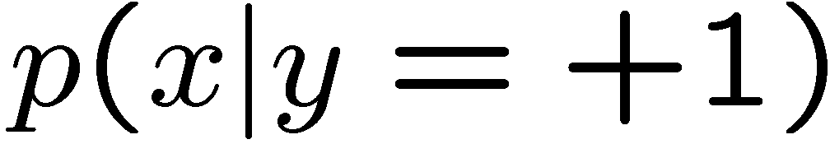
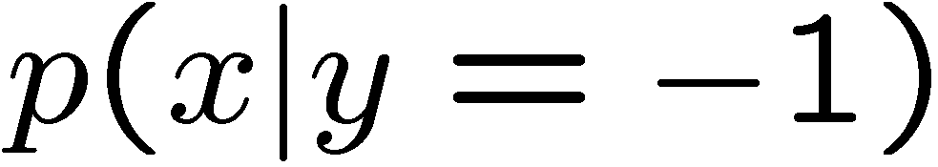
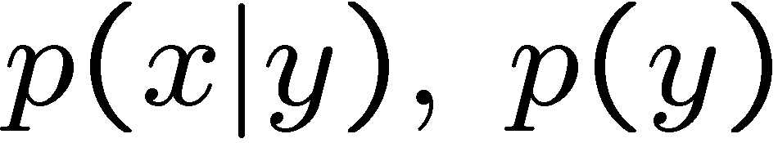
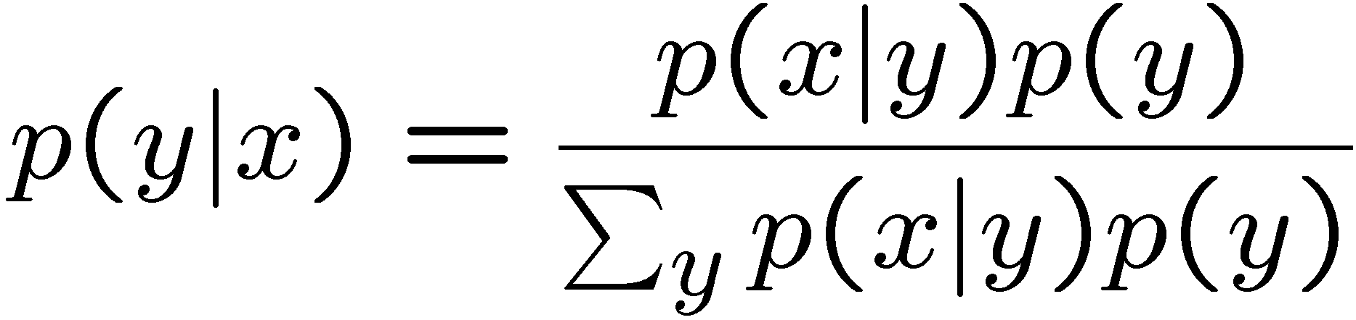
Discriminative v.s. Generative Models
Discriminative models, either explicitly or implicitly, study the posterior distribution directly.
Generative approaches model the likelihood and prior separately.

Slide 4
Some Literature
Discriminative Approaches:
Perceptron and Neural networks (Rosenblatt 1958, Windrow and Hoff 1960, Hopfiled 1982, Rumelhart and McClelland 1986, Lecun et al. 1998)
Nearest neighborhood classifier (Hart 1968)
Fisher linear discriminant analysis(Fisher)
Support Vector Machine (Vapnik 1995)
Bagging, Boosting,… (Breiman 1994, Freund and Schapire 1995, Friedman et al. 1998,)
…
Generative Approaches:
PCA, TCA, ICA (Karhunen and Loeve 1947, H´erault et al. 1980, Frey and Jojic 1999)
MRFs, Particle Filtering (Ising, Geman and Geman 1994, Isard and Blake 1996)
Maximum Entropy Model (Della Pietra et al. 1997, Zhu et al. 1997, Hinton 2002)
Deep Nets (Hinton et al. 2006)
….

Slide 5
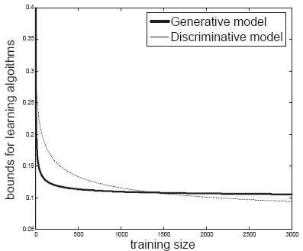
Pros and Cons of Discriminative Models
Some general views, but might be outdated
Pros:
Focused on discrimination and marginal distributions.
Easier to learn/compute than generative models (arguable).
Good performance with large training volume.
Often fast.
Cons:
Limited modeling capability.
Can not generate new data.
Require both positive and negative training data (mostly).
Performance largely degrades on small size training data.

Slide 6

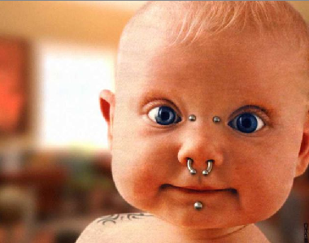

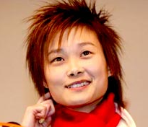

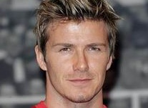
Intuition about Margin
Elderly
Infant
?
Man
?
Woman

Slide 7
Problem with All Margin-based Discriminative Classifier
It might be very miss-leading to return a high confidence.

Slide 8


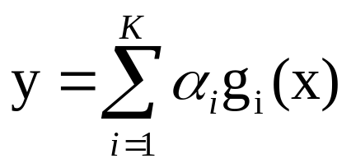



Several Pair of Concepts
Generative v.s. Discriminative
Parametric v.s. Non-parametric
Supervised v.s. Unsupervised
The gap between them is becoming increasingly small.

Slide 9
Parametric v.s. Non-parametric
Parametric:
Non-parametric:
logistic regression
Fisher discriminant analysis
Graphical models
hierarchical models
bagging, boosting
…
nearest neighborhood
kernel methods
decision tree
neural nets
Gaussian processes
…
It roughly depends on if the number of parameters increases with the number of samples.
Their distinction is not absolute.

Slide 10
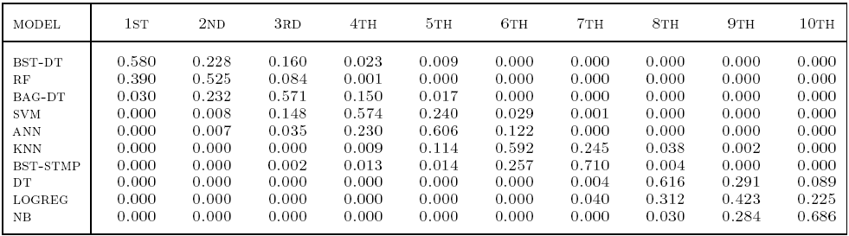
Empirical Comparisons of Different Algorithms
Caruana and Niculesu-Mizil, ICML 2006
Overall rank by mean performance across problems and metrics (based on bootstrap analysis).
BST-DT: boosting with decision tree weak classifier RF: random forest
BAG-DT: bagging with decision tree weak classifier SVM: support vector machine
ANN: neural nets KNN: k nearest neighboorhood
BST-STMP: boosting with decision stump weak classifier DT: decision tree
LOGREG: logistic regression NB: naïve Bayesian
It is informative, but by no means final.

Slide 11
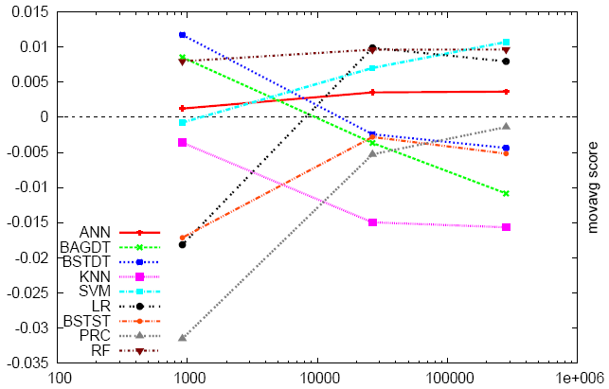
Empirical Study on High-dimension
Caruana et al., ICML 2008
Moving average standardized scores of each learning algorithm as a function of the dimension.
The rank for the algorithms to perform consistently well:
(1) random forest (2) neural nets (3) boosted tree (4) SVMs

Slide 12
Ensemble Methods
Bagging (Breiman 1994,…)
Boosting (Freund and Schapire 1995, Friedman et al. 1998,…)
Random forests (Breiman 2001,…)
Predict class label for unseen data by aggregating a set of predictions (classifiers learned from the training data).

Slide 13
General Idea
S
Training Data
Multiple Data Sets
S1
S2
Sn
Multiple Classifiers
C1
C2
Cn
Combined Classifier
H

Slide 14
Build Ensemble Classifiers
Basic idea:
Build different “experts”, and let them vote
Advantages:
Improve predictive performance
Other types of classifiers can be directly included
Easy to implement
No too much parameter tuning
Disadvantages:
The combined classifier is not so transparent (black box)
Not a compact representation

Slide 15
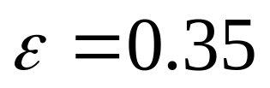
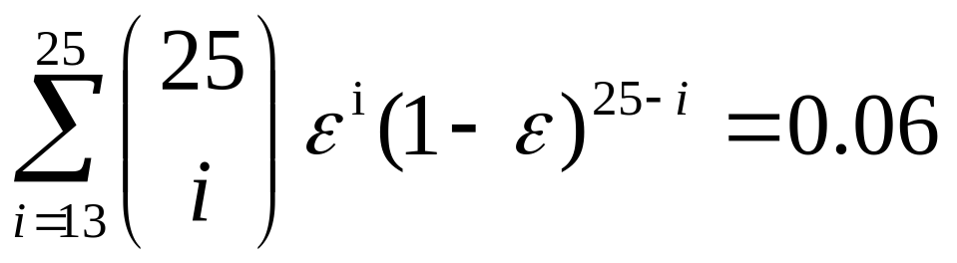
Why do they work?
Suppose there are 25 base classifiers
Each classifier has error rate,
Assume independence among classifiers
Probability that the ensemble classifier makes a wrong prediction:

Slide 16
Bagging
Training
Given a dataset S, at each iteration i, a training set Si is sampled with replacement from S (i.e. bootstraping)
A classifier Ci is learned for each Si
Classification: given an unseen sample X,
Each classifier Ci returns its class prediction
The bagged classifier H counts the votes and assigns the class with the most votes to X
Regression: can be applied to the prediction of continuous values by taking the average value of each prediction.

Slide 17
Bagging
Bagging works because it reduces variance by voting/averaging
In some pathological hypothetical situations the overall error might increase
Usually, the more classifiers the better
Problem: we only have one dataset.
Solution: generate new ones of size n by bootstrapping, i.e. sampling it with replacement
Can help a lot if data is noisy.

Slide 18
Bias-variance Decomposition
Used to analyze how much selection of any specific training set affects performance
Assume infinitely many classifiers, built from different training sets
For any learning scheme,
Bias = expected error of the combined classifier on new data
Variance = expected error due to the particular training set used
Total expected error ~ bias + variance

Slide 19
When does Bagging work?
Learning algorithm is unstable: if small changes to the training set cause large changes in the learned classifier.
If the learning algorithm is unstable, then Bagging almost always improves performance
Some candidates:
Decision tree, decision stump, regression tree, linear regression, SVMs

Slide 20
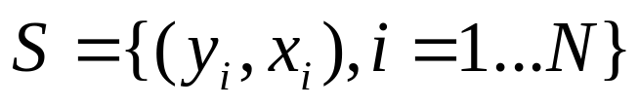
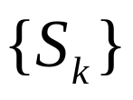

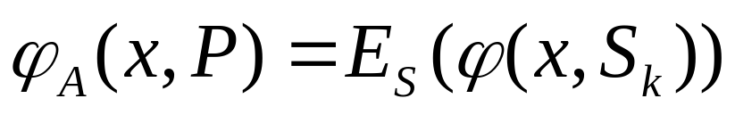
Why Bagging works?
Let be the set of training dataset
Let be a sequence of training sets containing a sub-set of
Let P be the underlying distribution of .
Bagging replaces the prediction of the model with the majority of the predictions given by the classifiers

Slide 21
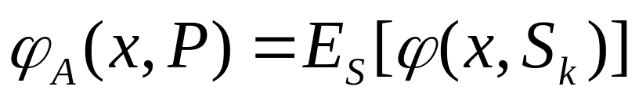
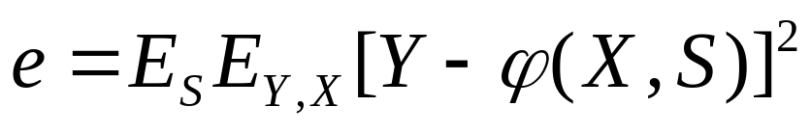
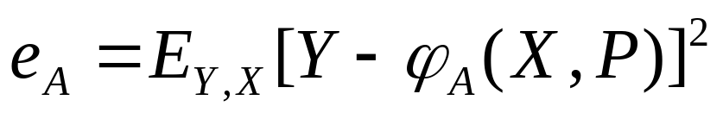
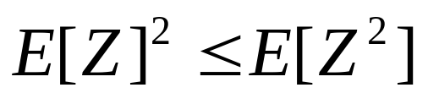
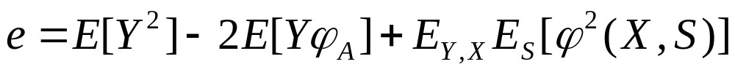
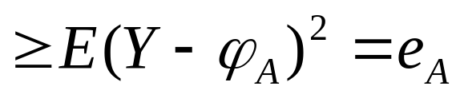
Why Bagging works?
Direct error:
Bagging error:
Jensen’s inequality:

Slide 22
Randomization
Can randomize learning algorithms instead of inputs
Some algorithms already have random component: e.g. random initialization
Most algorithms can be randomized
Pick from the N best options at random instead of always picking the best one
Split rule in decision tree
Random projection in kNN (Freund and Dasgupta 08)

Slide 23
Ensemble Methods
Bagging (Breiman 1994,…)
Boosting (Freund and Schapire 1995, Friedman et al. 1998,…)
Random forests (Breiman 2001,…)

Slide 24
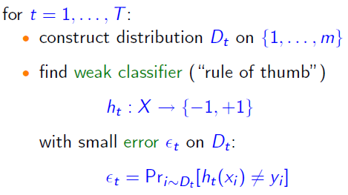

A Formal Description of Boosting

Slide 25

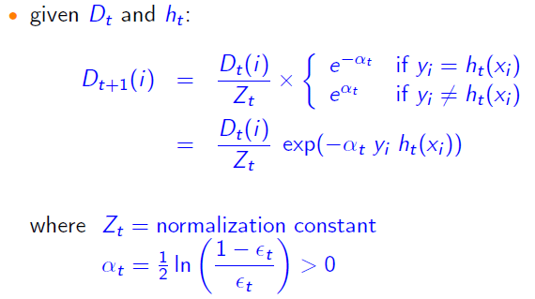
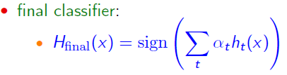
AdaBoost (Freund and Schpaire)
( not necessarily with equal weight)

Slide 26
Toy Example

Slide 27
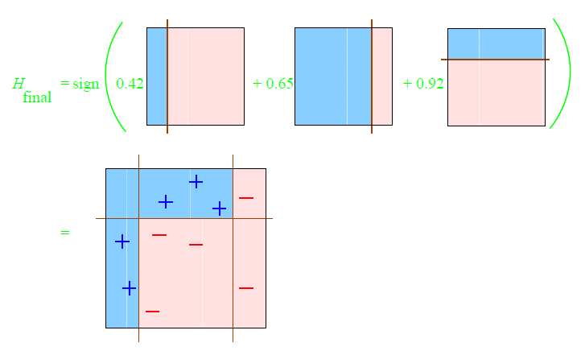
Final Classifier

Slide 28
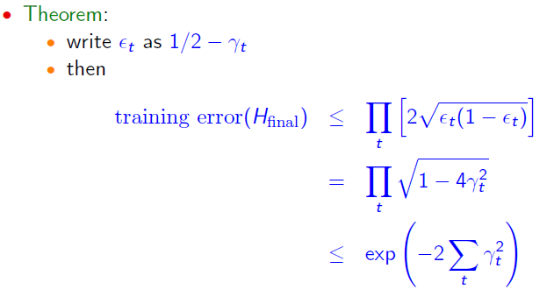
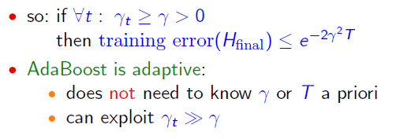
Training Error

Slide 29
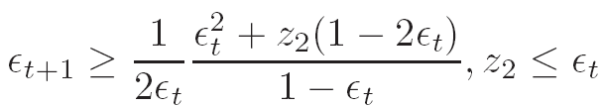


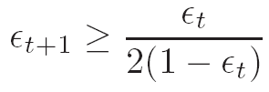
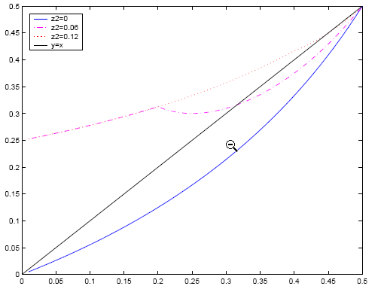
Training Error
Tu et al. 2006
Two take home messages:
(1) The first chosen weak learner is already informative about the difficulty of the classification algorithm
(1) Bound is achieved when they are complementary to each other.

Slide 30
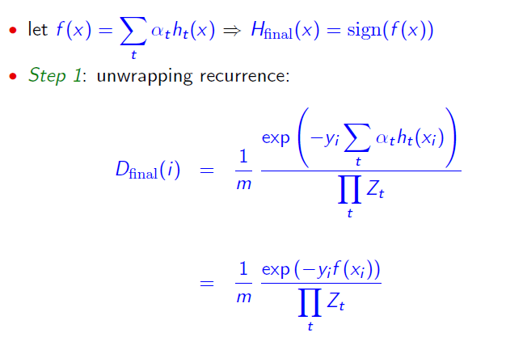
Training Error

Slide 31
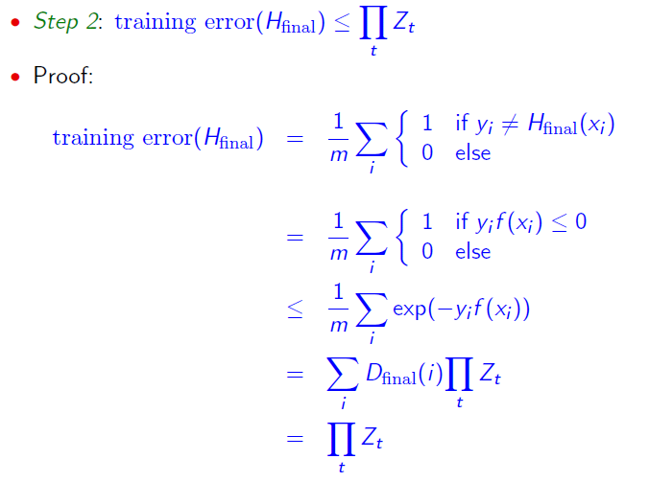
Training Error

Slide 32
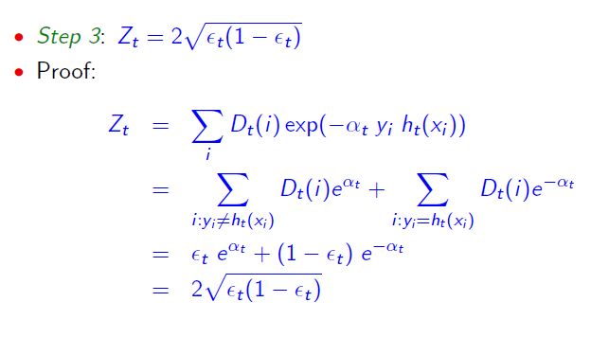
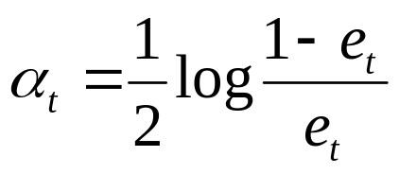
Training Error

Slide 33
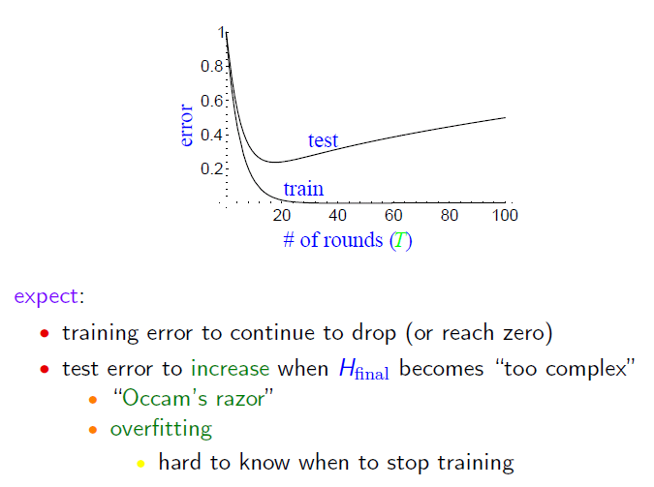
Test Error?

Slide 34
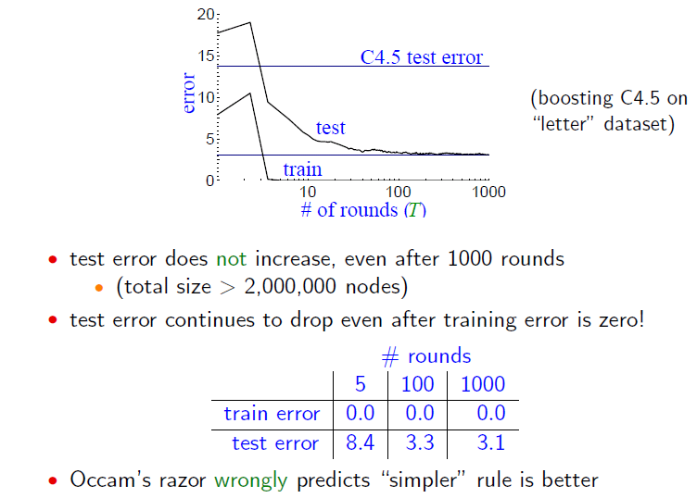
Test Error

Slide 35
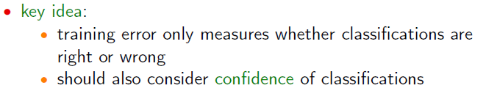
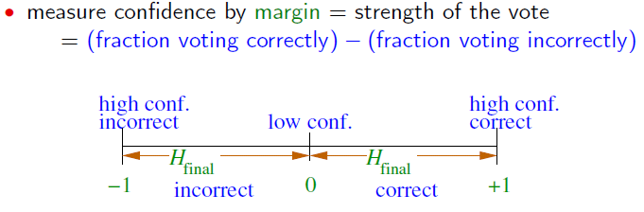
The Margin Explanation

Slide 36
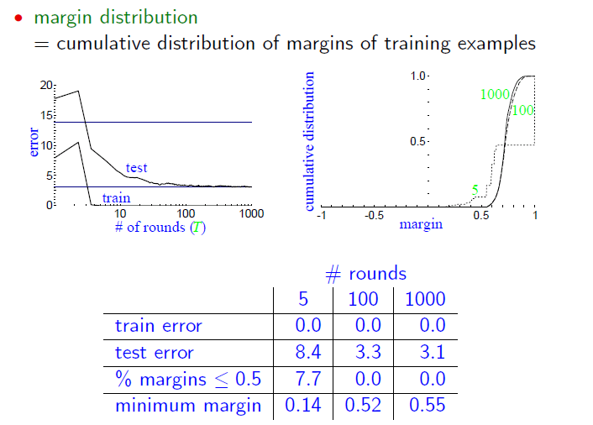
The Margin Distribution

Slide 37
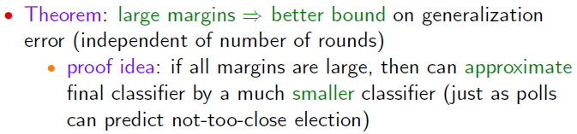
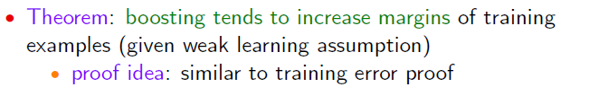
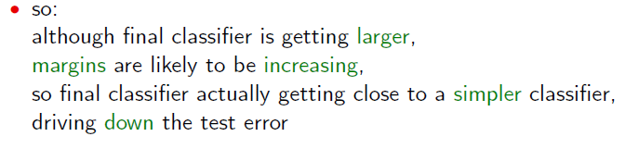
Margin Analysis

Slide 38
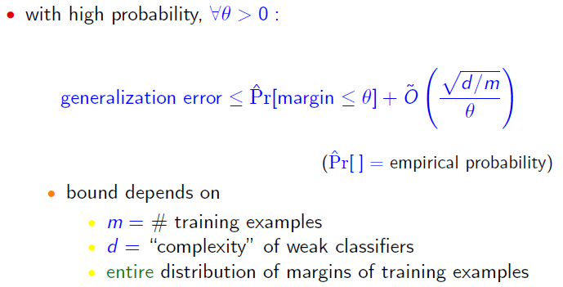
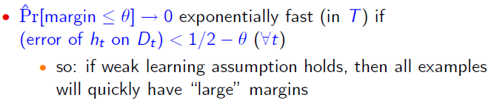
Theoretical Analysis

Slide 39
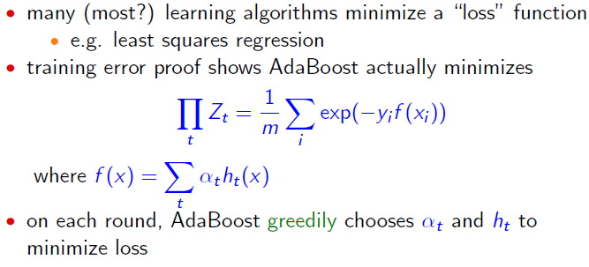
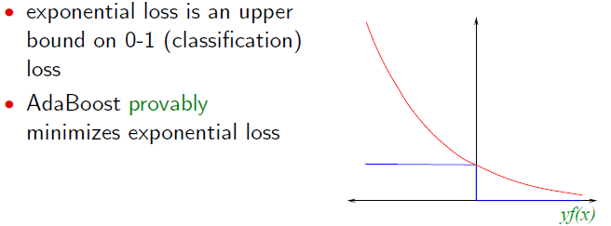
AdaBoost and Exponential Loss

Slide 40
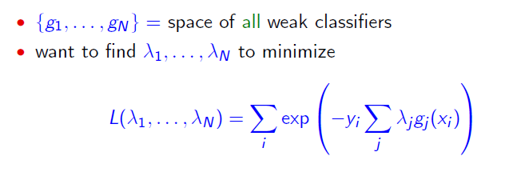

Coordinate Descent Explanation

Slide 41






Coordinate Descent Explanation
Step 1: find the best to minimize the error.
Step 2: estimate to minimize the error on

Slide 42


Logistic Regression View

Slide 43


Benefits of Model Fitting View

Slide 44
Advantages of Boosting
Simple and easy to implement
Flexible– can combine with any learning algorithm
No requirement on data metric– data features don’t need to be normalized, like in kNN and SVMs (this has been a central problem in machine learning)
Feature selection and fusion are naturally combined with the same goal for minimizing an objective error function
No parameters to tune (maybe T)
No prior knowledge needed about weak learner
Provably effective
Versatile– can be applied on a wide variety of problems
Non-parametric

Slide 45
Caveats
Performance of AdaBoost depends on data and weak learner
Consistent with theory, AdaBoost can fail if
weak classifier too complex– overfitting
weak classifier too weak -- underfitting
Empirically, AdaBoost seems especially susceptible to uniform noise

Slide 46

Variations of Boosting
Confidence rated Predictions (Singer and Schapire)

Slide 47

Confidence Rated Prediction

Slide 48






Variations of Boosting (Friedman et al. 98)
The AdaBoost (discrete) algorithm fits an additive logistic regression model by using adaptive Newton updates for minimizing

Slide 49

LogiBoost
The LogiBoost algorithm uses adaptive Newton steps for fitting an additive symmetric logistic model by maximum likelihood.

Slide 50

Real AdaBoost
The Real AdaBoost algorithm fits an additive logistic regression model by stage-wise optimization of

Slide 51

Gental AdaBoost
The Gental AdaBoost algorithmuses adaptive Newton steps for minimizing

Slide 52



Choices of Error Functions

Slide 53

Multi-Class Classification
One v.s. All seems to work very well most of the time.
R. Rifkin and A. Klautau, “In defense of one-vs-all classification”, J. Mach. Learn. Res, 2004
Error output code seems to be useful when the number of classes is big.

Slide 54




Data-assisted Output Code (Jiang and Tu 09)

Slide 55
Ensemble Methods
Bagging (Breiman 1994,…)
Boosting (Freund and Schapire 1995, Friedman et al. 1998,…)
Random forests (Breiman 2001,…)

Slide 56

Random Forests
Random forests (RF) are a combination of tree predictors
Each tree depends on the values of a random vector sampled in dependently
The generalization error depends on the strength of the individual trees and the correlation between them
Using a random selection of features yields results favorable to AdaBoost, and are more robust w.r.t. noise

Slide 57
The Random Forests Algorithm
Given a training set S
For i = 1 to k do:
Build subset Si by sampling with replacement from S
Learn tree Ti from Si
At each node:
Choose best split from random subset of F features
Each tree grows to the largest extend, and no pruning
Make predictions according to majority vote of the set of k trees.

Slide 58
Features of Random Forests
It is unexcelled in accuracy among current algorithms.
It runs efficiently on large data bases.
It can handle thousands of input variables without variable deletion.
It gives estimates of what variables are important in the classification.
It generates an internal unbiased estimate of the generalization error as the forest building progresses.
It has an effective method for estimating missing data and maintains accuracy when a large proportion of the data are missing.
It has methods for balancing error in class population unbalanced data sets.

Slide 59
Features of Random Forests
Generated forests can be saved for future use on other data.
Prototypes are computed that give information about the relation between the variables and the classification.
It computes proximities between pairs of cases that can be used in clustering, locating outliers, or (by scaling) give interesting views of the data.
The capabilities of the above can be extended to unlabeled data, leading to unsupervised clustering, data views and outlier detection.
It offers an experimental method for detecting variable interactions.

Slide 60
Compared with Boosting
Pros:
It is more robust.
It is faster to train (no reweighting, each split is on a small subset of data and feature).
Can handle missing/partial data.
Is easier to extend to online version.
Cons:
The feature selection process is not explicit.
Feature fusion is also less obvious.
Has weaker performance on small size training data.

Slide 61

Problems with On-line Boosting
The weights are changed gradually, but not the weak learners themselves!
Random forests can handle on-line more naturally.
Oza and Russel

Slide 62



Face Detection
Viola and Jones 2001
A landmark paper in vision!
HOG, part-based..
A large number of Haar features.
Use of integral images.
Cascade of classifiers.
Boosting.
RF, SVM, PBT, NN
All the components can be replaced now.

Slide 63
Empirical Observatations
Boosting-decision tree (C4.5) often works very well.
2~3 level decision tree has a good balance between effectiveness and efficiency.
Random Forests requires less training time.
They both can be used in regression.
One-vs-all works well in most cases in multi-class classification.
They both are implicit and not so compact.

Slide 64
Ensemble Methods
Random forests (also true for many machine learning algorithms) is an example of a tool that is useful in doing analyses of scientific data.
But the cleverest algorithms are no substitute for human intelligence and knowledge of the data in the problem.
Take the output of random forests not as absolute truth, but as smart computer generated guesses that may be helpful in leading to a deeper understanding of the problem.
Leo Brieman

